Slide 1
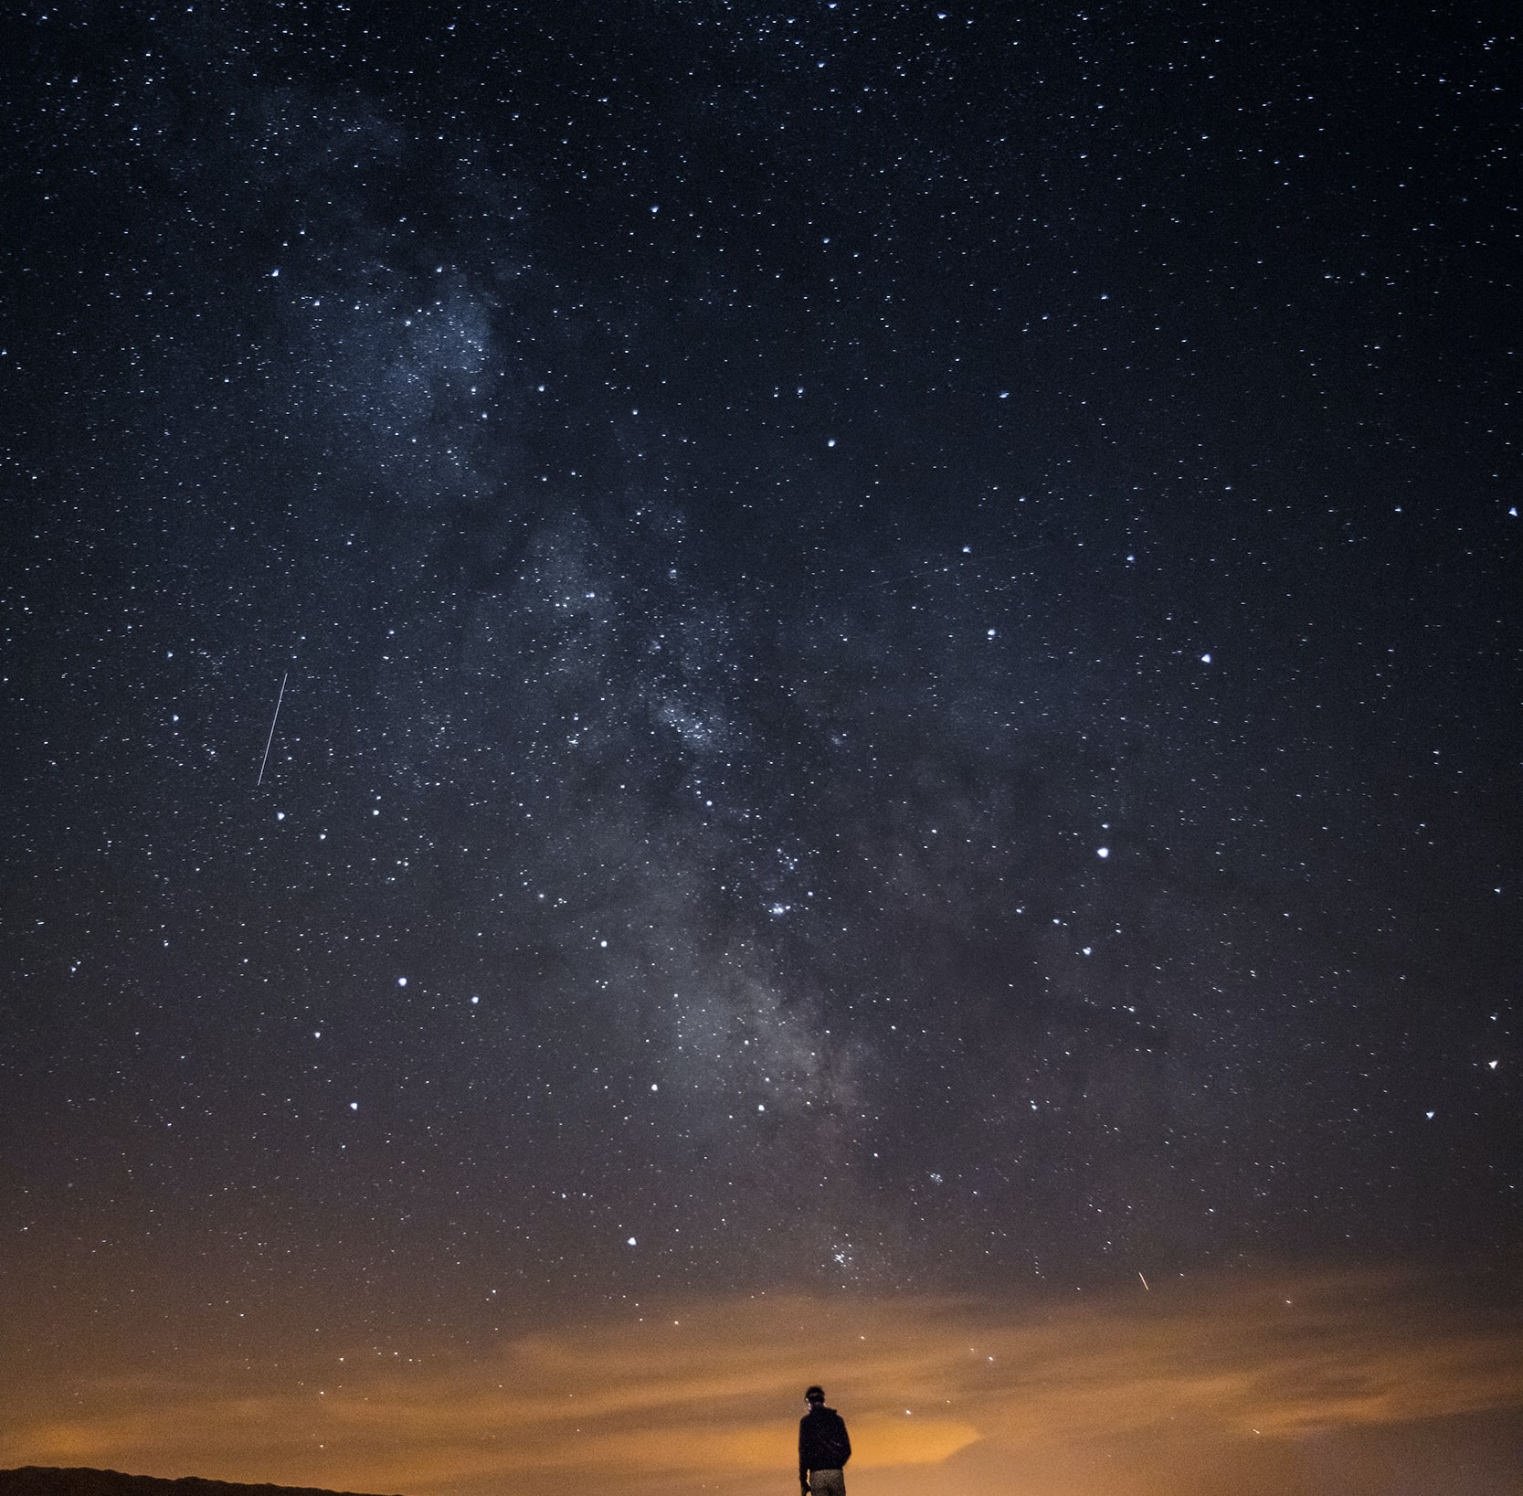

Creative Programming and Computing
Music and Acoustic Engineering
«E quindi uscimmo a riveder le stelle»
Inferno XXXIV, 139
Creative Programming and Computing
Music and Acoustic Engineering
Politecnico di Milano
Federico Ceriola – Gian Marco De Bortoli – Bruno Sciarrone
a.a. 2021/2022

Slide 2
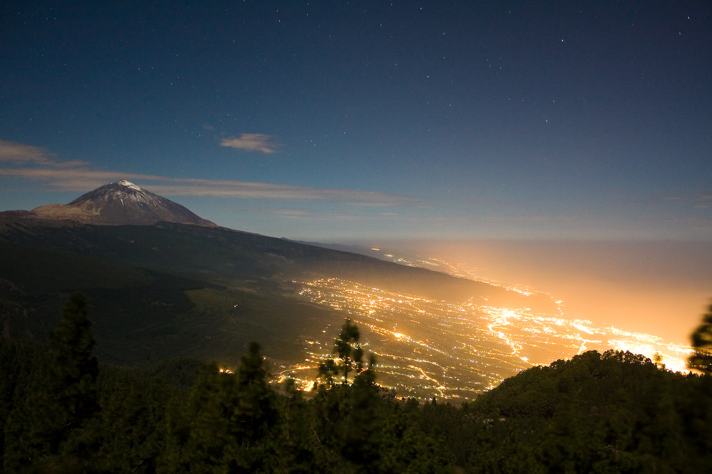
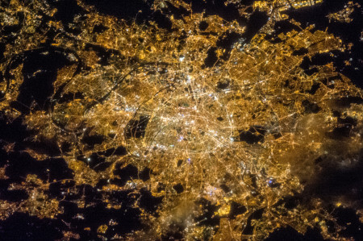
Creative Programming and Computing
Music and Acoustic Engineering
Main Concept:
Light pollution affects life:
It contributes to climate change.
It kills millions of birds a year.
Artificial light at night disrupts the seasonal cycle of trees.
Relevant number of people have never seen the real sky at night (the Milky Way).
Exposure to artificial light at night puts your health at risk.
Federico Ceriola – Gian Marco De Bortoli – Bruno Sciarrone
a.a. 2021/2022

Slide 3


Creative Programming and Computing
Music and Acoustic Engineering
Our Story:
Interactive Installation
Imagine you could switch off all the artificial lights above your head.
You would be able to see the real natural light of the dark sky.
It would be the same experience of a child discovering the world, with equal curiosity and astonishment.
Visual and sound discovering experience
Federico Ceriola – Gian Marco De Bortoli – Bruno Sciarrone
a.a. 2021/2022

Slide 4
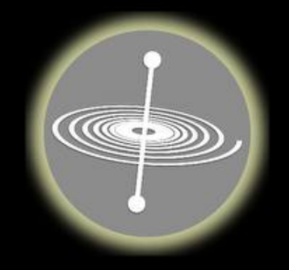
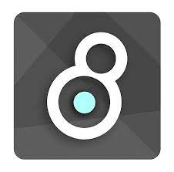
Creative Programming and Computing
Music and Acoustic Engineering
User’s interaction
SIGNAL ROUTING
Auxiliary Audio Out
OSC messages
GyrOSC
Audio signal
Video signal
Processing
Max4Live
Ableton Live
Video Out
Audio Out
Perception
Federico Ceriola – Gian Marco De Bortoli – Bruno Sciarrone
a.a. 2021/2022

Slide 5
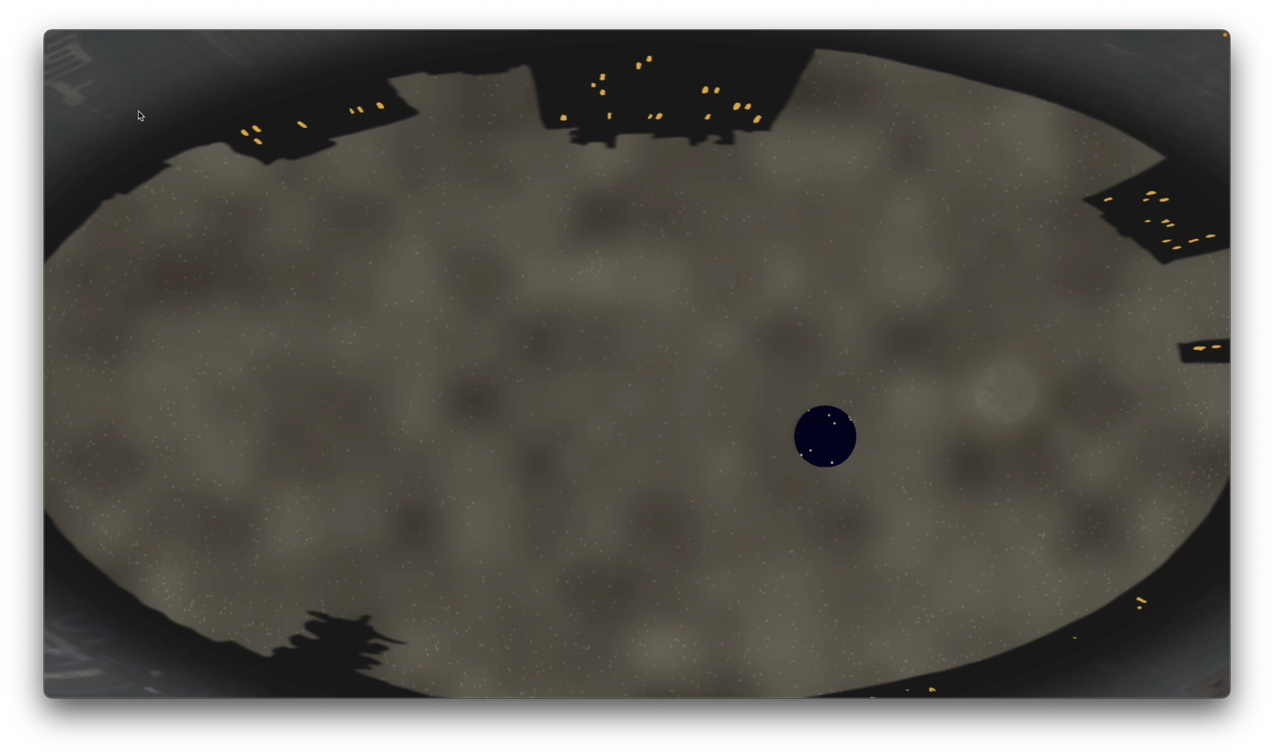
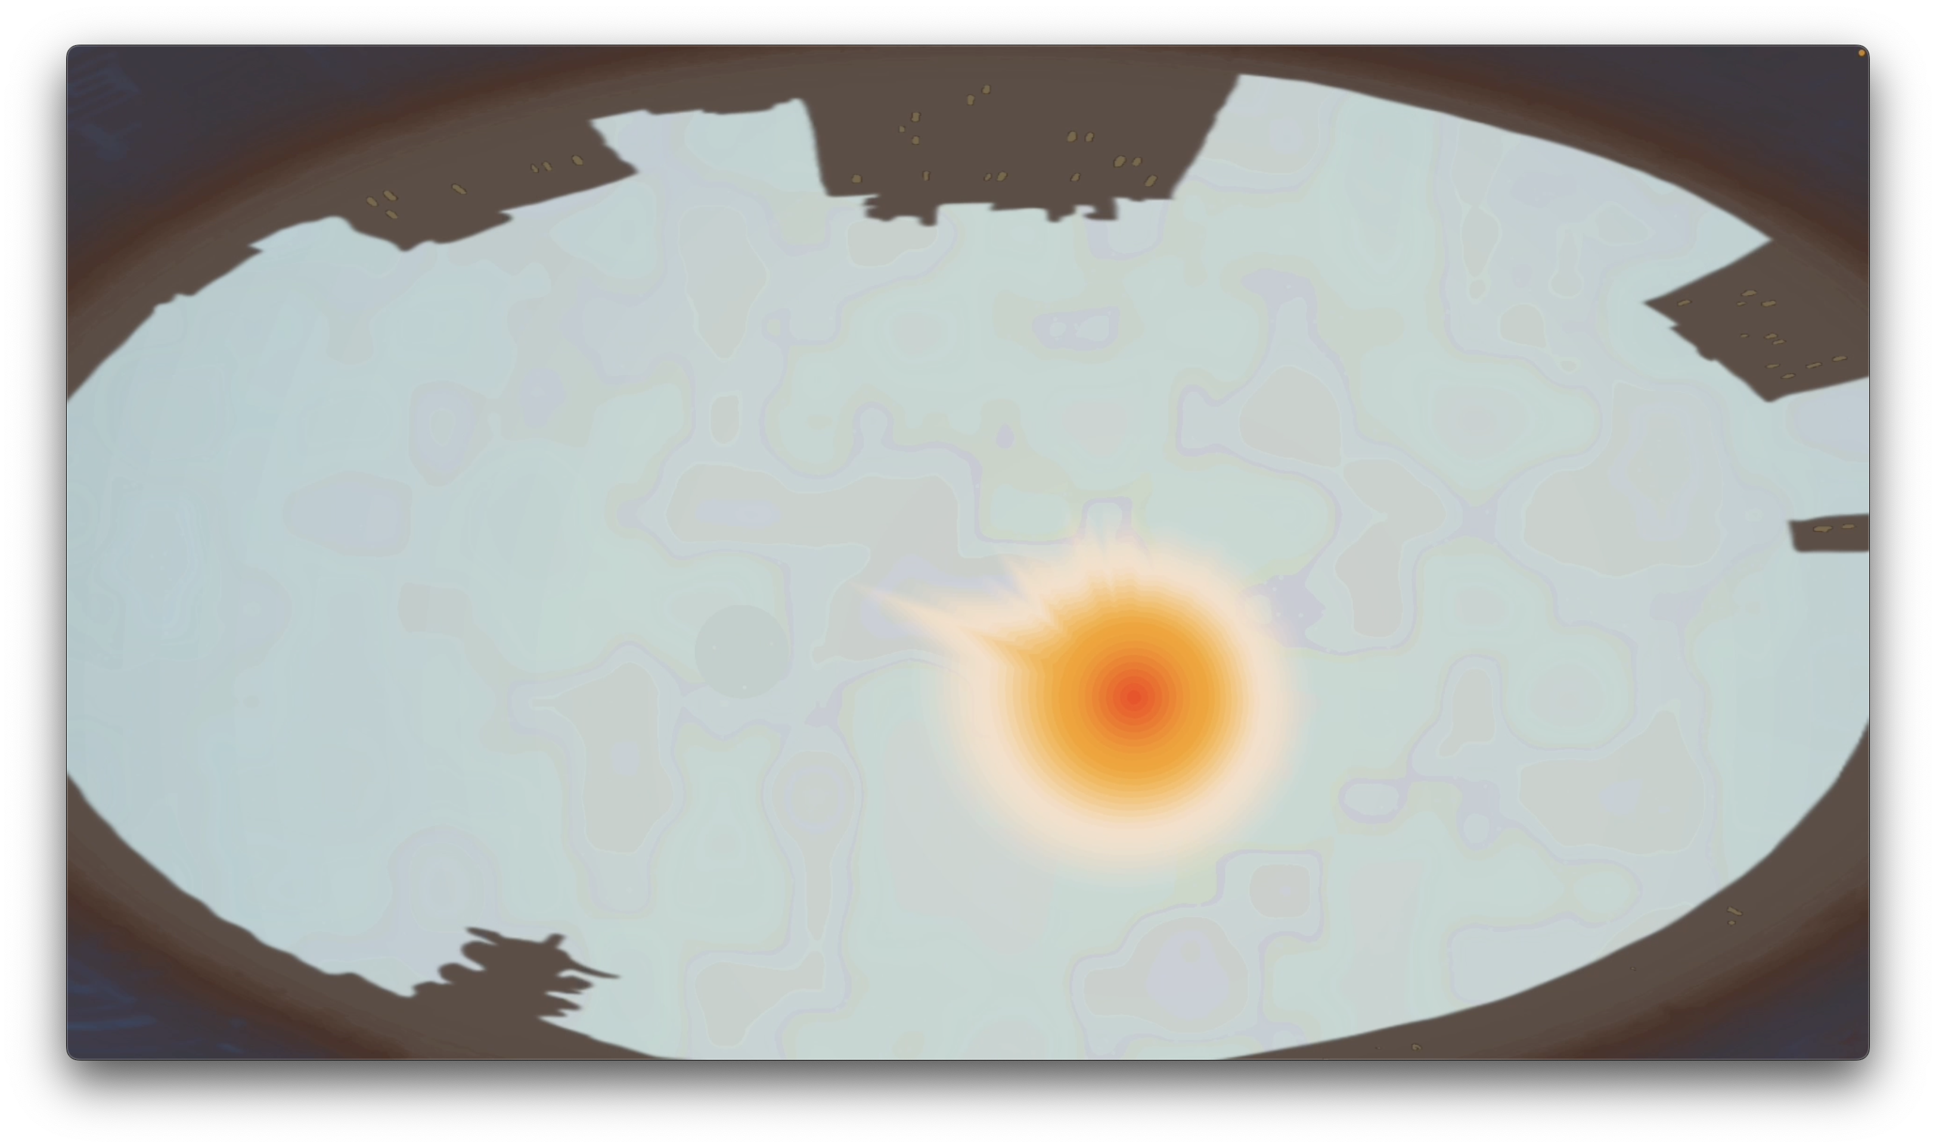
Creative Programming and Computing
Music and Acoustic Engineering
Design – Evolution in time
Night:
Interaction with the application
Presence of the Moon
Visible pollution
Day:
Immersive auditory experience
Presence of the Sun
Federico Ceriola – Gian Marco De Bortoli – Bruno Sciarrone
a.a. 2021/2022

Slide 6

Creative Programming and Computing
Music and Acoustic Engineering
Design – Evolution in space
Stars layer
Real database with information about coordinates (J2000), temperature and visual magnitude
Current time at application first launch
GPS position of the user
Projection in cartesian coordinates
Colour based on the temperature
Dimension and Opacity based on visual magnitude
Federico Ceriola – Gian Marco De Bortoli – Bruno Sciarrone
a.a. 2021/2022

Slide 7
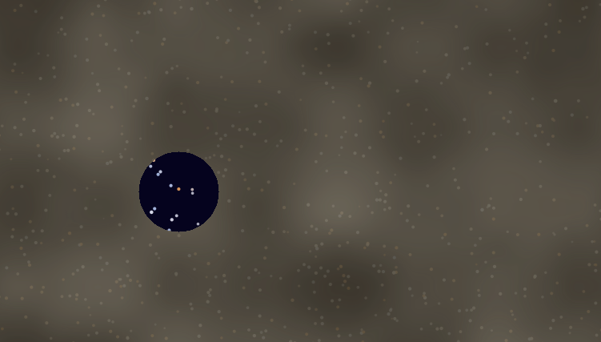

Creative Programming and Computing
Music and Acoustic Engineering
Pollution layer
3D Perlin Noise technique
Cone of visibility from which we gather information:
- density of the stars
- dominant colour
Sky
Colour interpolation
Opacity controlled by sound intensity
Federico Ceriola – Gian Marco De Bortoli – Bruno Sciarrone
a.a. 2021/2022

Slide 8
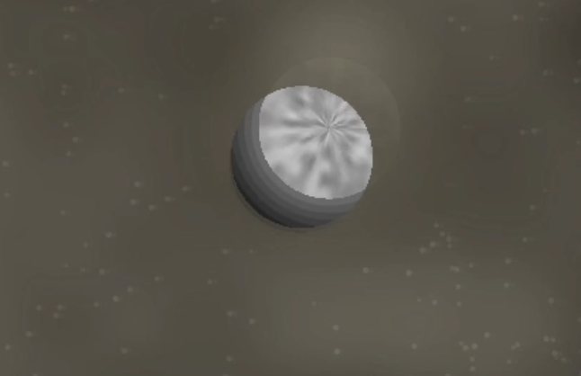
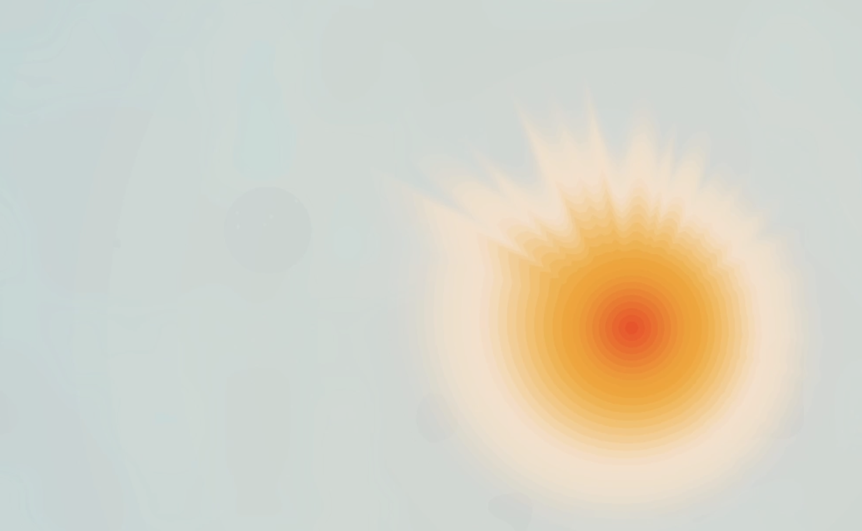
Creative Programming and Computing
Music and Acoustic Engineering
Moon
Rendered with the use of the 2D Perlin Noise
Interaction with the pointer
Sun
Sound spectrum analysis visualization
Amplitude spectrum wrapped around the center composing the sun’s rays
Federico Ceriola – Gian Marco De Bortoli – Bruno Sciarrone
a.a. 2021/2022

Slide 9
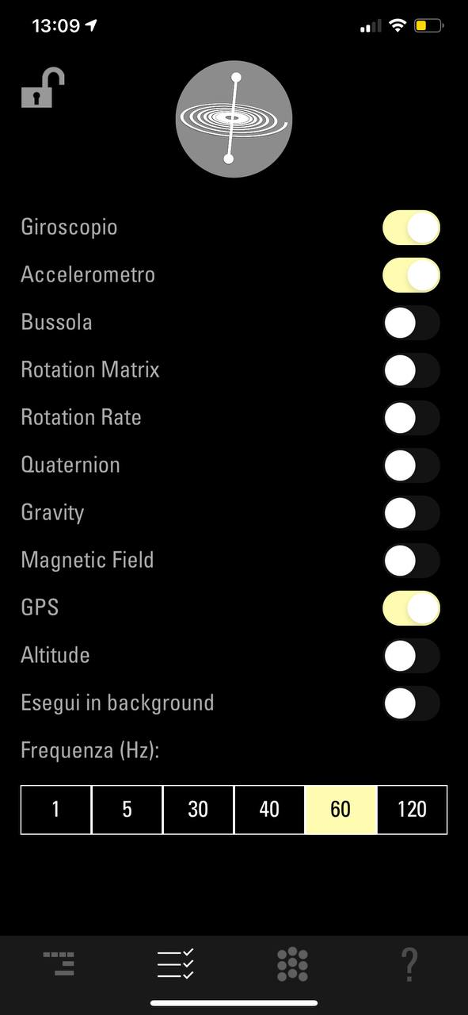
Creative Programming and Computing
Music and Acoustic Engineering
Interaction – OSC messages
The interaction takes place in the main, and is made entirely with OSC messages.
The user interacts with the application with GyrOSC application on any device where the app is available;
GyrOSC sends three adresses, which are the gyroscope, the accelerometer and the GPS, that are received by Processing and used to build the pointer.
Federico Ceriola – Gian Marco De Bortoli – Bruno Sciarrone
a.a. 2021/2022

Slide 10
Creative Programming and Computing
Music and Acoustic Engineering
Interaction – Gyroscope
The first address sent from GyrOSC is the gyroscope, with /gyrosc/gyro;
Constitutes the most relevant parameter for the “moving” experience of the pointer
The gyroscope has two relevant parameters, which constitute the moving direction and angles in the x and y axis.
Federico Ceriola – Gian Marco De Bortoli – Bruno Sciarrone
a.a. 2021/2022

Slide 11
Creative Programming and Computing
Music and Acoustic Engineering
Interaction – Accelerometer
The second parameter sent is the accelerometer, with /gyrosc/accel
Contributes to the acceleration in the pointer movement, with is also processed with sound, using a filter.
Send two values from GyrOSC, relative to the acceleration in the x and y axis and taken and processed by Processing.
Federico Ceriola – Gian Marco De Bortoli – Bruno Sciarrone
a.a. 2021/2022

Slide 12
Creative Programming and Computing
Music and Acoustic Engineering
Interaction – GPS
GPS constitutes the last address sent from GyrOSC to Processing, with the address /gyrosc/gps.
Send two values, latitude and longitude.
These values are then used inside starsTable for the first reading of the database, to obtain a reference for horizontal coordinates of the star system.
Federico Ceriola – Gian Marco De Bortoli – Bruno Sciarrone
a.a. 2021/2022

Slide 13
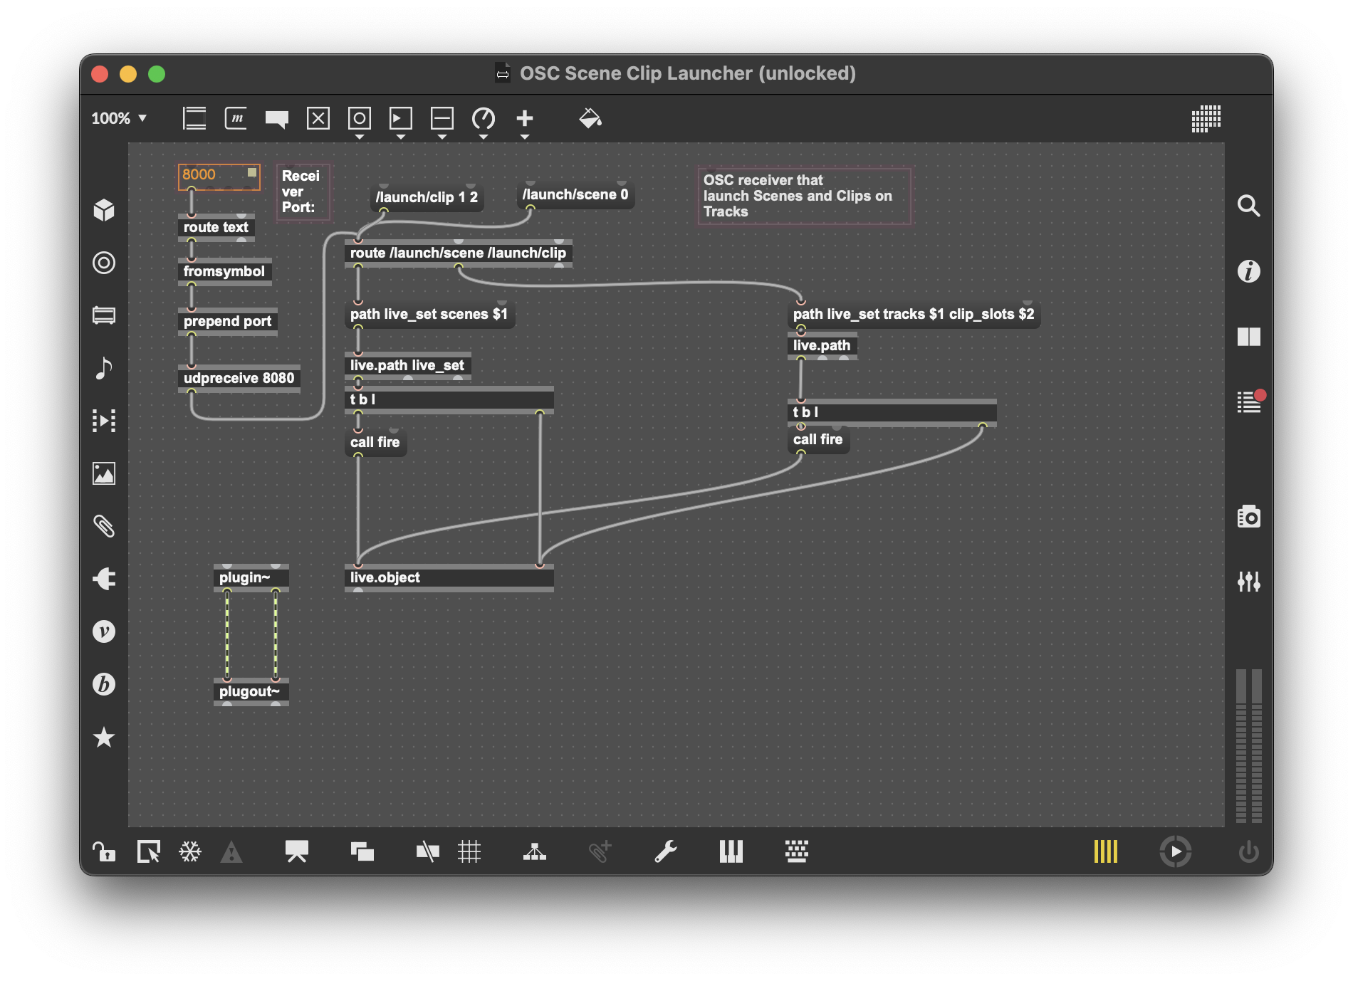
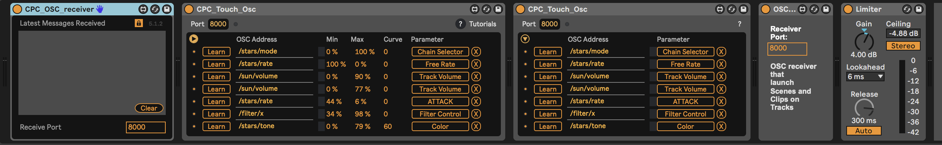
Creative Programming and Computing
Music and Acoustic Engineering
Sound Generation
The OSC messages are received through the device of the Connection Kit.
The scene change is driven by a custom device built in M4L.
Federico Ceriola – Gian Marco De Bortoli – Bruno Sciarrone
a.a. 2021/2022

Slide 14
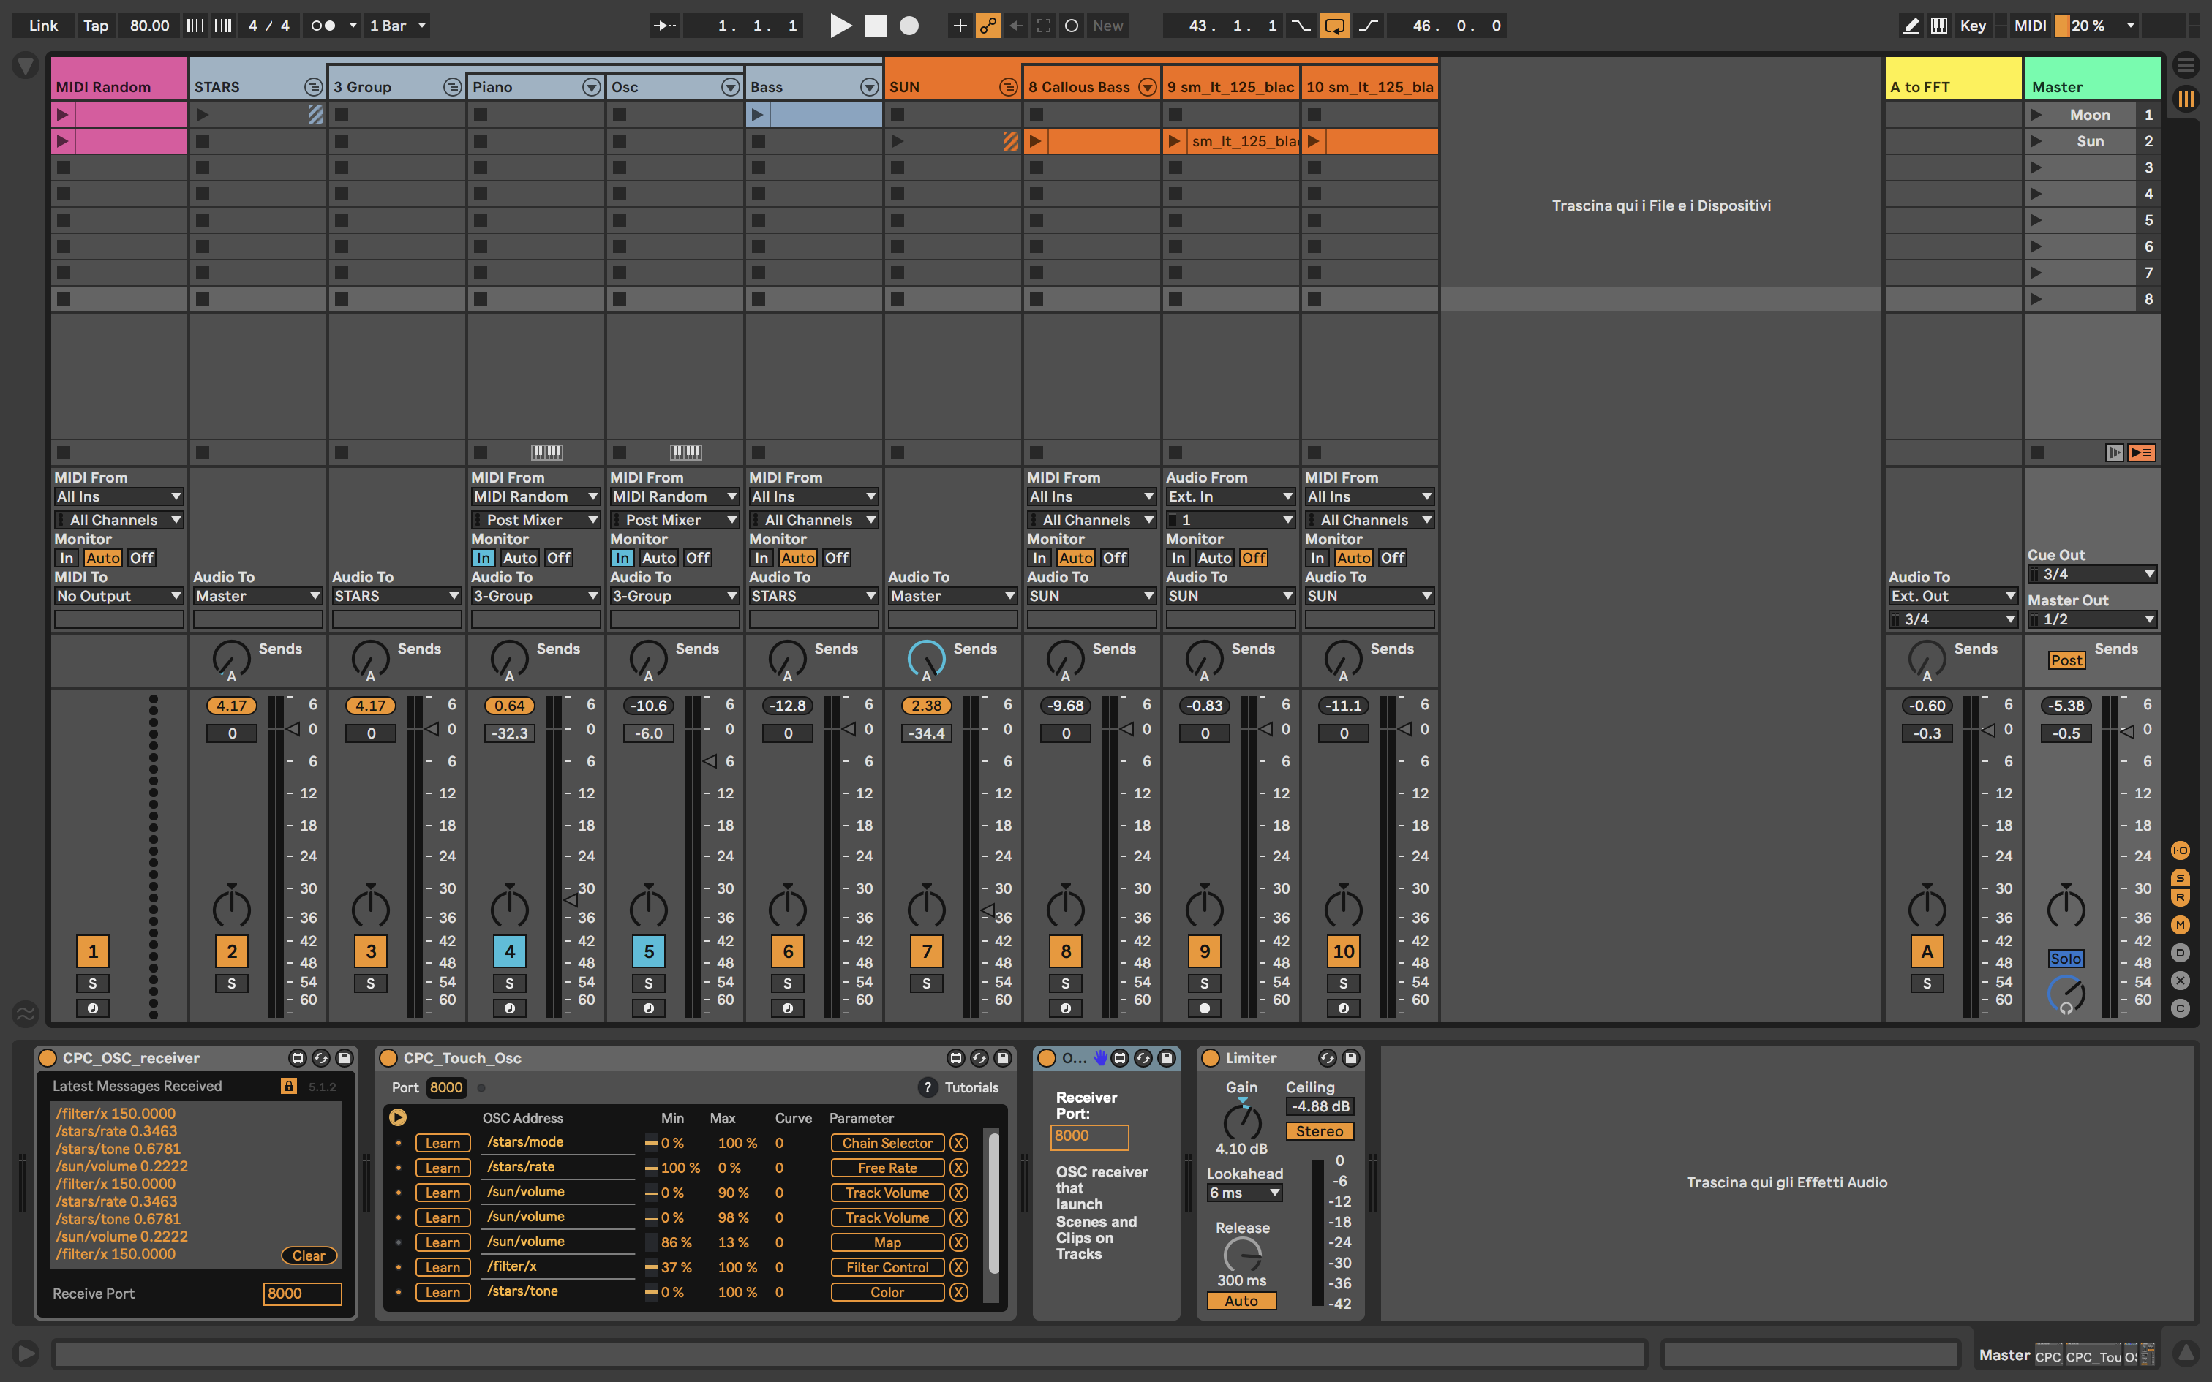
Creative Programming and Computing
Music and Acoustic Engineering
Sound Generation – Scene Overview
Federico Ceriola – Gian Marco De Bortoli – Bruno Sciarrone
a.a. 2021/2022

Slide 15
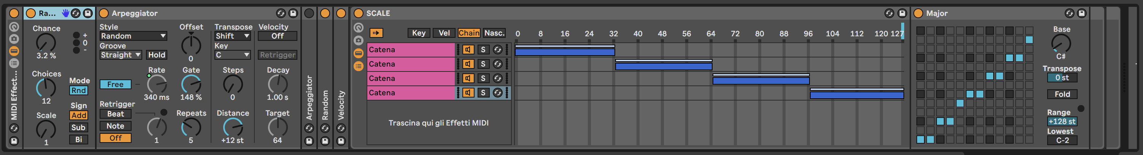
Creative Programming and Computing
Music and Acoustic Engineering
Sound Generation – MIDI notes
Arpeggiator
Random
Velocity
MIDI Chain Selector: Scale selector
The arpeggiator rate is driven by the value of the star’s density
Federico Ceriola – Gian Marco De Bortoli – Bruno Sciarrone
a.a. 2021/2022

Slide 16
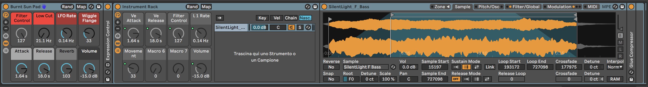
Creative Programming and Computing
Music and Acoustic Engineering
Sound Generation – STARS
FM Oscillator - Night time
Piano – Day time
Bass Synth
The Filter of the Bass synth is controlled by the accelerometer on the user’s device.
The note are generated by the MIDI notes generator.
Federico Ceriola – Gian Marco De Bortoli – Bruno Sciarrone
a.a. 2021/2022

Slide 17

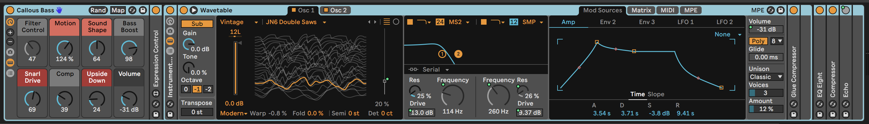
Creative Programming and Computing
Music and Acoustic Engineering
Sound Generation – SUN
Sonorization of the sun’s electromagnetic waves
Chopped sample of the electromagnetic waves (Simpler)
Bass Synth made with wave table
The Filter of the Bass synth is controlled by the accelerometer on the user’s device.
The section’s volume is driven by the position of the sun, which is sent to the FFT visualization.
Federico Ceriola – Gian Marco De Bortoli – Bruno Sciarrone
a.a. 2021/2022

Slide 18
Creative Programming and Computing
Music and Acoustic Engineering
Improvements
More users.
Motion tracking of the users with cameras. The users are the pointers.
Use of the whole 3D geometry of the room.
Improvements on the computational cost.
Different sounding landscapes based on the season cycle.
Different celestial bodies.
Federico Ceriola – Gian Marco De Bortoli – Bruno Sciarrone
a.a. 2021/2022

Slide 19
Creative Programming and Computing
Music and Acoustic Engineering
Special thanks to
Dr. Lorenzo Pizzuti
Cosmologist, Musician and Scientific Communicator
Federico Ceriola – Gian Marco De Bortoli – Bruno Sciarrone
a.a. 2021/2022

Slide 20
Creative Programming and Computing
Music and Acoustic Engineering
DEMO
Federico Ceriola – Gian Marco De Bortoli – Bruno Sciarrone
a.a. 2021/2022

Slide 21
Creative Programming and Computing
Music and Acoustic Engineering
Thanks for your attention
Federico Ceriola – Gian Marco De Bortoli – Bruno Sciarrone
a.a. 2021/2022

